Slide 1


Advisory
Raymond Chabot Grant Thornton
CCH Tagetik delivery team

Slide 2
Raymond Chabot Grant Thornton: a strong local presence
Who is Raymond Chabot Grant Thornton?
More than
More than
75 years
200
With a solid infrastructure integrated into the business, political and social communities, the strength of our network is reflected in our presence in Quebec, eastern Ontario and New Brunswick.
From Edmundston to Ottawa, Kuujjuaq to Coaticook, our professionals know the local business environment and are connected to the ecosystem of the regions in which they operate.
In business
partners
Some
Over
100
50,000
offices
clients
More than
2,900
professionals

Slide 3



Integrated services
Who is Raymond Chabot Grant Thornton?
Assurance
Audit, review and compilation engagement;
Accounting assistance – payroll and bookkeeping;
Public offerings – public companies;
Operio – accounting consulting services.
Advisory
Financial consulting;
Management consulting;
Human resources consulting;
Risk management consulting.
Recovery and reorganization
Businesses;
Individuals;
Class actions (Proactio).
Subsidiary
Find out more
Tax
Canadian, U.S. and international taxation;
Training in taxation and finance;
SR&ED and innovation;
Commodity taxes;
Centre québécois de formation en fiscalité (CQFF).

Slide 4
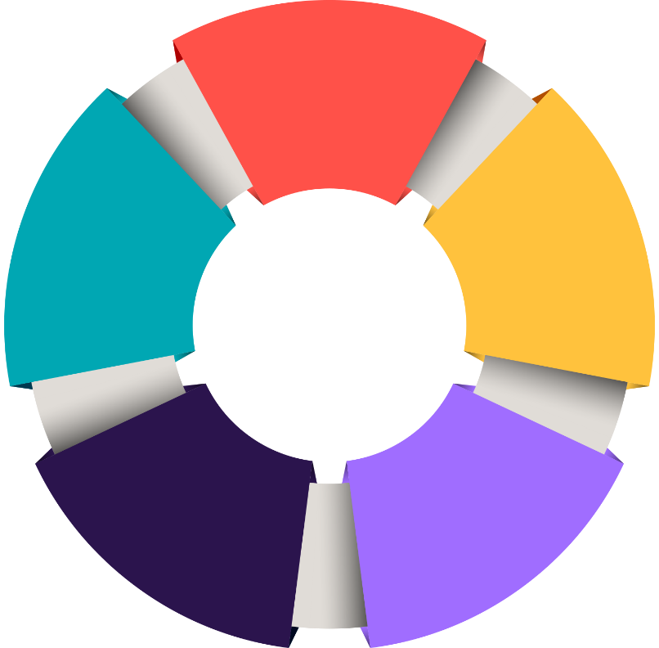
Introduction to our Advisory Services
Who is Raymond Chabot Grant Thornton?
Our Service Offering
  Performance Management
      EPM Process / Technology Enablement
      Advanced Analytics Modelling
      Cash Forecasting Technology Enablement
      Business Risk Management
  Strategy Management
      Business Vision and Strategy Definition
      4.0 Digital Strategy and Readiness Check
      Business Planning
      Economic Impact Analysis
      Succession Planning
RCGT’s Management Consulting Service
Offering
  Transformation
      Finance Process Optimization
      Finance Operating Model Diagnostic
      Post-Merger Integration
      Transformation Program and Change Management
  Technology
      Finance Applications Architecture Review
      Intelligent Automation (RPA and IA)
      IT Controls and Compliance Audit
      Information Systems Security Compliance (CISO)
      Cybersecurity
  Human Capital
      Talent Management
      Executive Search
      Psychometric Assessment
      Executive Coaching

Slide 5












CCH Tagetik Expertise
CCH Tagetik Partner since 2018
Montreal based, Bilingual
10+ consultants specialized on the solution, including Consolidation and FP&A certified resources
Combined functional finance/accounting expertise of CPAs with deep technical solution knowledge
Successful CCH Tagetik deployments in Canada over the last few years includes, CDPQ, Power Corporation, Harnois Energies, QSL, Bausch Health, Groupe Nutri, HGregoire, American Iron & Metal, and SMARDT
By combining both functional and technical expertise, we provide our customers with a best-in-class team to implement consolidation and planning processes in CCH Tagetik. This approach ensures deep solution knowledge and practical experience gained from working with similar organizations.

Slide 7
CCH® Tagetik
Enabling CFOs and their peers, in global enterprises, to propel their strategy with faster and better-informed decisions
more than
2500
applications
more than
2000
customers
more than
20
years
Across Multiple Industries
Banking &
Financial Services
Insurance
CPG
Manufacturing
Automotive
Power & Utilities
Chemical & Pharmaceuticals
Construction & Engineering
Professional Services
Healthcare
Not-for-Profit
Fashion
Retail
Clean Energy
6
CCH® Tagetik Corporate Sales Deck

Slide 8






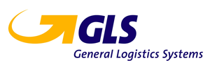













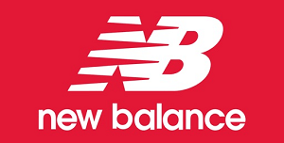














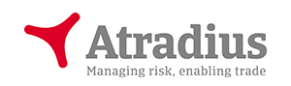






Selected customers from our global customer base
Insurance
Banking and Financial Services
Fashion
Manufacturing
Construction & Engineering
CPG & Retail
Professional
Services
Automotive
Power & Utilities
7
CCH® Tagetik Corporate Sales Deck

Slide 9
We have a long history of "firsts" for CFOs and their teams
Over 20+ years of continuous innovation for our customers
2008
CPM vendor with a platform, one database and a one application approach
2017
2024
Analytic Information Hub launch for granular financial and operational data management
2022
2013
2020
Intelligent
Platform launch – ML and Gen AI embedded analytics
AI-based ‘explainable’
predictive intelligence
ESG & Sustainability Performance Management launch
Global prepackaged applications launch
2014
2021
2025
2012
2018
2023
Extending the on-prem offering to the cloud
Extending IBP with finance-forward Supply Chain Planning
Native integration with SAP HANA database
Global Minimum Tax launch
Extensive AI adoption
Pervasive use of AI in CPM
Support integrated business and financial planning
CCH® Tagetik Corporate Sales Deck

Slide 10
CCH® Tagetik
Intelligent Platform
powered by AI with a Finance Brain
Analyze
Comply
Intelligent Platform
Forecast
Disclose
Close
CCH® Tagetik Corporate Sales Deck
Notes:
LESLIE
CCH Tagetik drives the digital transformation – enabling finance to close, disclose, comply, analyze and forecast from one unified platform –
Which is essential to closing the digital gaps of data, transformation, and compliance – and a key decision factor in why customers choose us
Ensuring the quality of enterprise data, leading digital transformation, and building a digital business strategy underpinned by finance

Slide 11
The scope of CPM is expanding to meet the evolving needs of the CFO
CCH® Tagetik keeps innovating in the Office of the CFO by strengthening its capabilities beyond core financial functions
while extending to other financial & operational adjacencies
Core Corporate Performance Management
Horizontal Adjacencies
Traditional FP&A
Extended
Planning
Tax Planning
IBP/Supply Chain Planning
Advanced Predictive Model
Strategic Planning
Annual Budgeting
Rolling Forecasts
Financial Consolidations
Technical
Accounting
Lease Accounting
Global Minimum Tax
Transaction Matching
Legal Entity Close (JE, AR…)
Group Close (multi-GAAP…)
Fin. Statements
Reporting
Analytics & Sustainability
Dashboarding
Data Visualization
ESG Reporting
Financial Reporting
Performance Reporting
Regulatory Reporting

Slide 12
CCH Tagetik Intelligent Solutions elevate CPM processes and beyond with platform wide AI capabilities
Intelligent Disclosure
Financial Reporting, Management Reporting, ESG Reporting, Tax Reporting
Disclosure Management
Financial Close
& Consolidation
ESG & Regulatory
Corporate Tax
Extended
Planning
Account Reconciliation
Consolidation
Financial & Management Reporting
Disclosure Management
iXBRL
ESG & Sustainability Reporting
Lease Accounting (IFRS 16 & ASC 842)
IFRS 17 Insurance
Solvency II (Pillar I, II, III)
EBA Supervisory reporting
Global Minimum Tax
Country-by-Country Reporting (CbCR)
Group Tax Provision and Reporting
Other Tax
Financial Planning
Operational planning
ESG planning
Integrated Business Planning
Supply Chain planning
Industry-specific solutions
Notes:
Intelligent Solutions
The information which is collected in the Intelligent Foundation layers can all be leverage by our intelligent solutions which form the backbone of our finance platform. This section contains all of the solutions which you need to respond to the requirements in the office of finance for Financial Close&Consolidation, Extended Planning, Corporate Tax and ESG & Regulatory reporing.
All of this financial and non-financial data can be accessed by means of Intelligent Disclosure Soution.
here you can leverage Ai capabilities from data collection to prediction . Do you need to assure data quality? AI Anomaly detection is your ally. Then you can understand the root causes of your current performance thanks to our AI driver-based analysis and use this knowledge to project your business with our Predictive Intelligence (that is already available). Now you have a story to tell your stakeholders and your board.
You can go From data to story with Intelligent Solutions: together with our FC&C, ESG and Corporate tax and Extended Planning we provide you with a new solution – CCH Tagetik
Intelligent Disclosure – that redefines the approach to managing disclosure from annual report to board book and others..
From data insights you can take informed business decisions, and we empower you with new Intelligent Analytics capabilities that allow you to create dashboard and graph to visualize your data, supercharged by Generative AI superpowers thanks to ASK AI.
We give you the power to take your data experience to the next level. Starting today you can break data silos more efficiently, get data visualization on the fly with unprecedented speed and accuracy in performance analysis, all effortlessly using natural multilanguage or intuitive self-service design.
This is a crucial step towards a smarter data consumption experience that will democratize access to business information by removing barriers related to technical skills, steep learning curves and foreign languages, allowing you to immediately exercise your financial acumen and talent.
We started this journey with a clear goal in mind : to improve the productivity in the office of finance, enabling a better understanding of business performance and, in short, simplifying life using natural languages and preventing you from being overwhelmed by tons of data and technicalities.

Slide 13
Our CCH Tagetik Intelligent Platform
Intelligent
Insights
Ask AI
Intelligent Analytics
Intelligent
Solutions
Intelligent Disclosure
Financial Close
& Consolidation
Account Reconciliation
Consolidation
Financial & Management Reporting
Disclosure Management
iXBRL
Extended
Planning
Financial Planning
Operational planning
Integrated Business Planning
Supply Chain planning
Industry-specific solutions
ESG &
Regulatory
ESG & Sustainability Reporting
Lease Accounting
(IFRS 16 & ASC 842)
IFRS 17 Insurance
Solvency II (Pillar I, II, III)
EBA Supervisory reporting
Corporate
Tax
Global Minimum Tax
Country-by-Country Reporting (CbCR)
Group Tax Provision and Reporting
Transfer Pricing
Learning Hub
Intelligent
Foundation
Objective AI
AI Automapping
AI Anomaly detection
AI Transaction Matching
AI Driver
Based Analysis
Predictive Intelligence
Data Hub layer (AIH)
Connectivity layer (APIs)
CCH® Tagetik Corporate Sales Deck

Slide 14
CCH Tagetik ESG & Sustainability Performance Management
ESG data ingestion, normalization, reporting, analysis and disclosure
ESG & Regulatory
CSRD
EU Taxonomy
Planning & Analytics
CBAM
Carbon Emissions
Metrics & KPIs
Collect, report, and disclose according to CSRD and related ESRS standards
Collect, report, and disclose to accelerate your EU Taxonomy compliance
Collect and manage granular data to calculate Scope 1, 2 and 3 emissions according to GHG protocol
Collect, report, and disclose according to ESG frameworks (GRI, SASB, IFRS, CDP, SBti, CCDAA …)
Analyze, plan and monitor sustainability projects concerning company’s strategy priorities
Collect, report, and disclose to comply with CBAM
Notes:
We have 3 modules
Eu taxonomy, taking care of the different req for different industries
ESG metrics and KPIs, including GRi; SASB, and more recently IFRS
CSRD, OUR BEST SELLER IN THE LAST 6MONTHS, as mentioned this must be pushed with urgency in all large/listed companies who reports to EU authority: they need to be ready on time.
Please note that our official deck includes all the KEY words, to explain the regulatory requirements and explain how we address them.

Slide 15


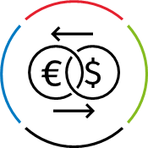
CCH Tagetik Corporate Tax Solutions
Harmonize finance and tax and optimize global tax strategy
Corporate Tax
Global Minimum Tax
Tax Provision & Reporting
Operational Transfer Pricing
Streamlines BEPS Pillar Two data collection, calculations, reporting, CbCR, and planning
A dedicated solution for multinationals to automate and optimize intercompany pricing, transforming a manual, retrospective task into a live, strategic function.
Harmonize tax data from entities, subgroups, regions, and disparate source systems at the group level
CCH® Tagetik Corporate Sales Deck
CCH® Tagetik Corporate Sales Deck

Slide 16
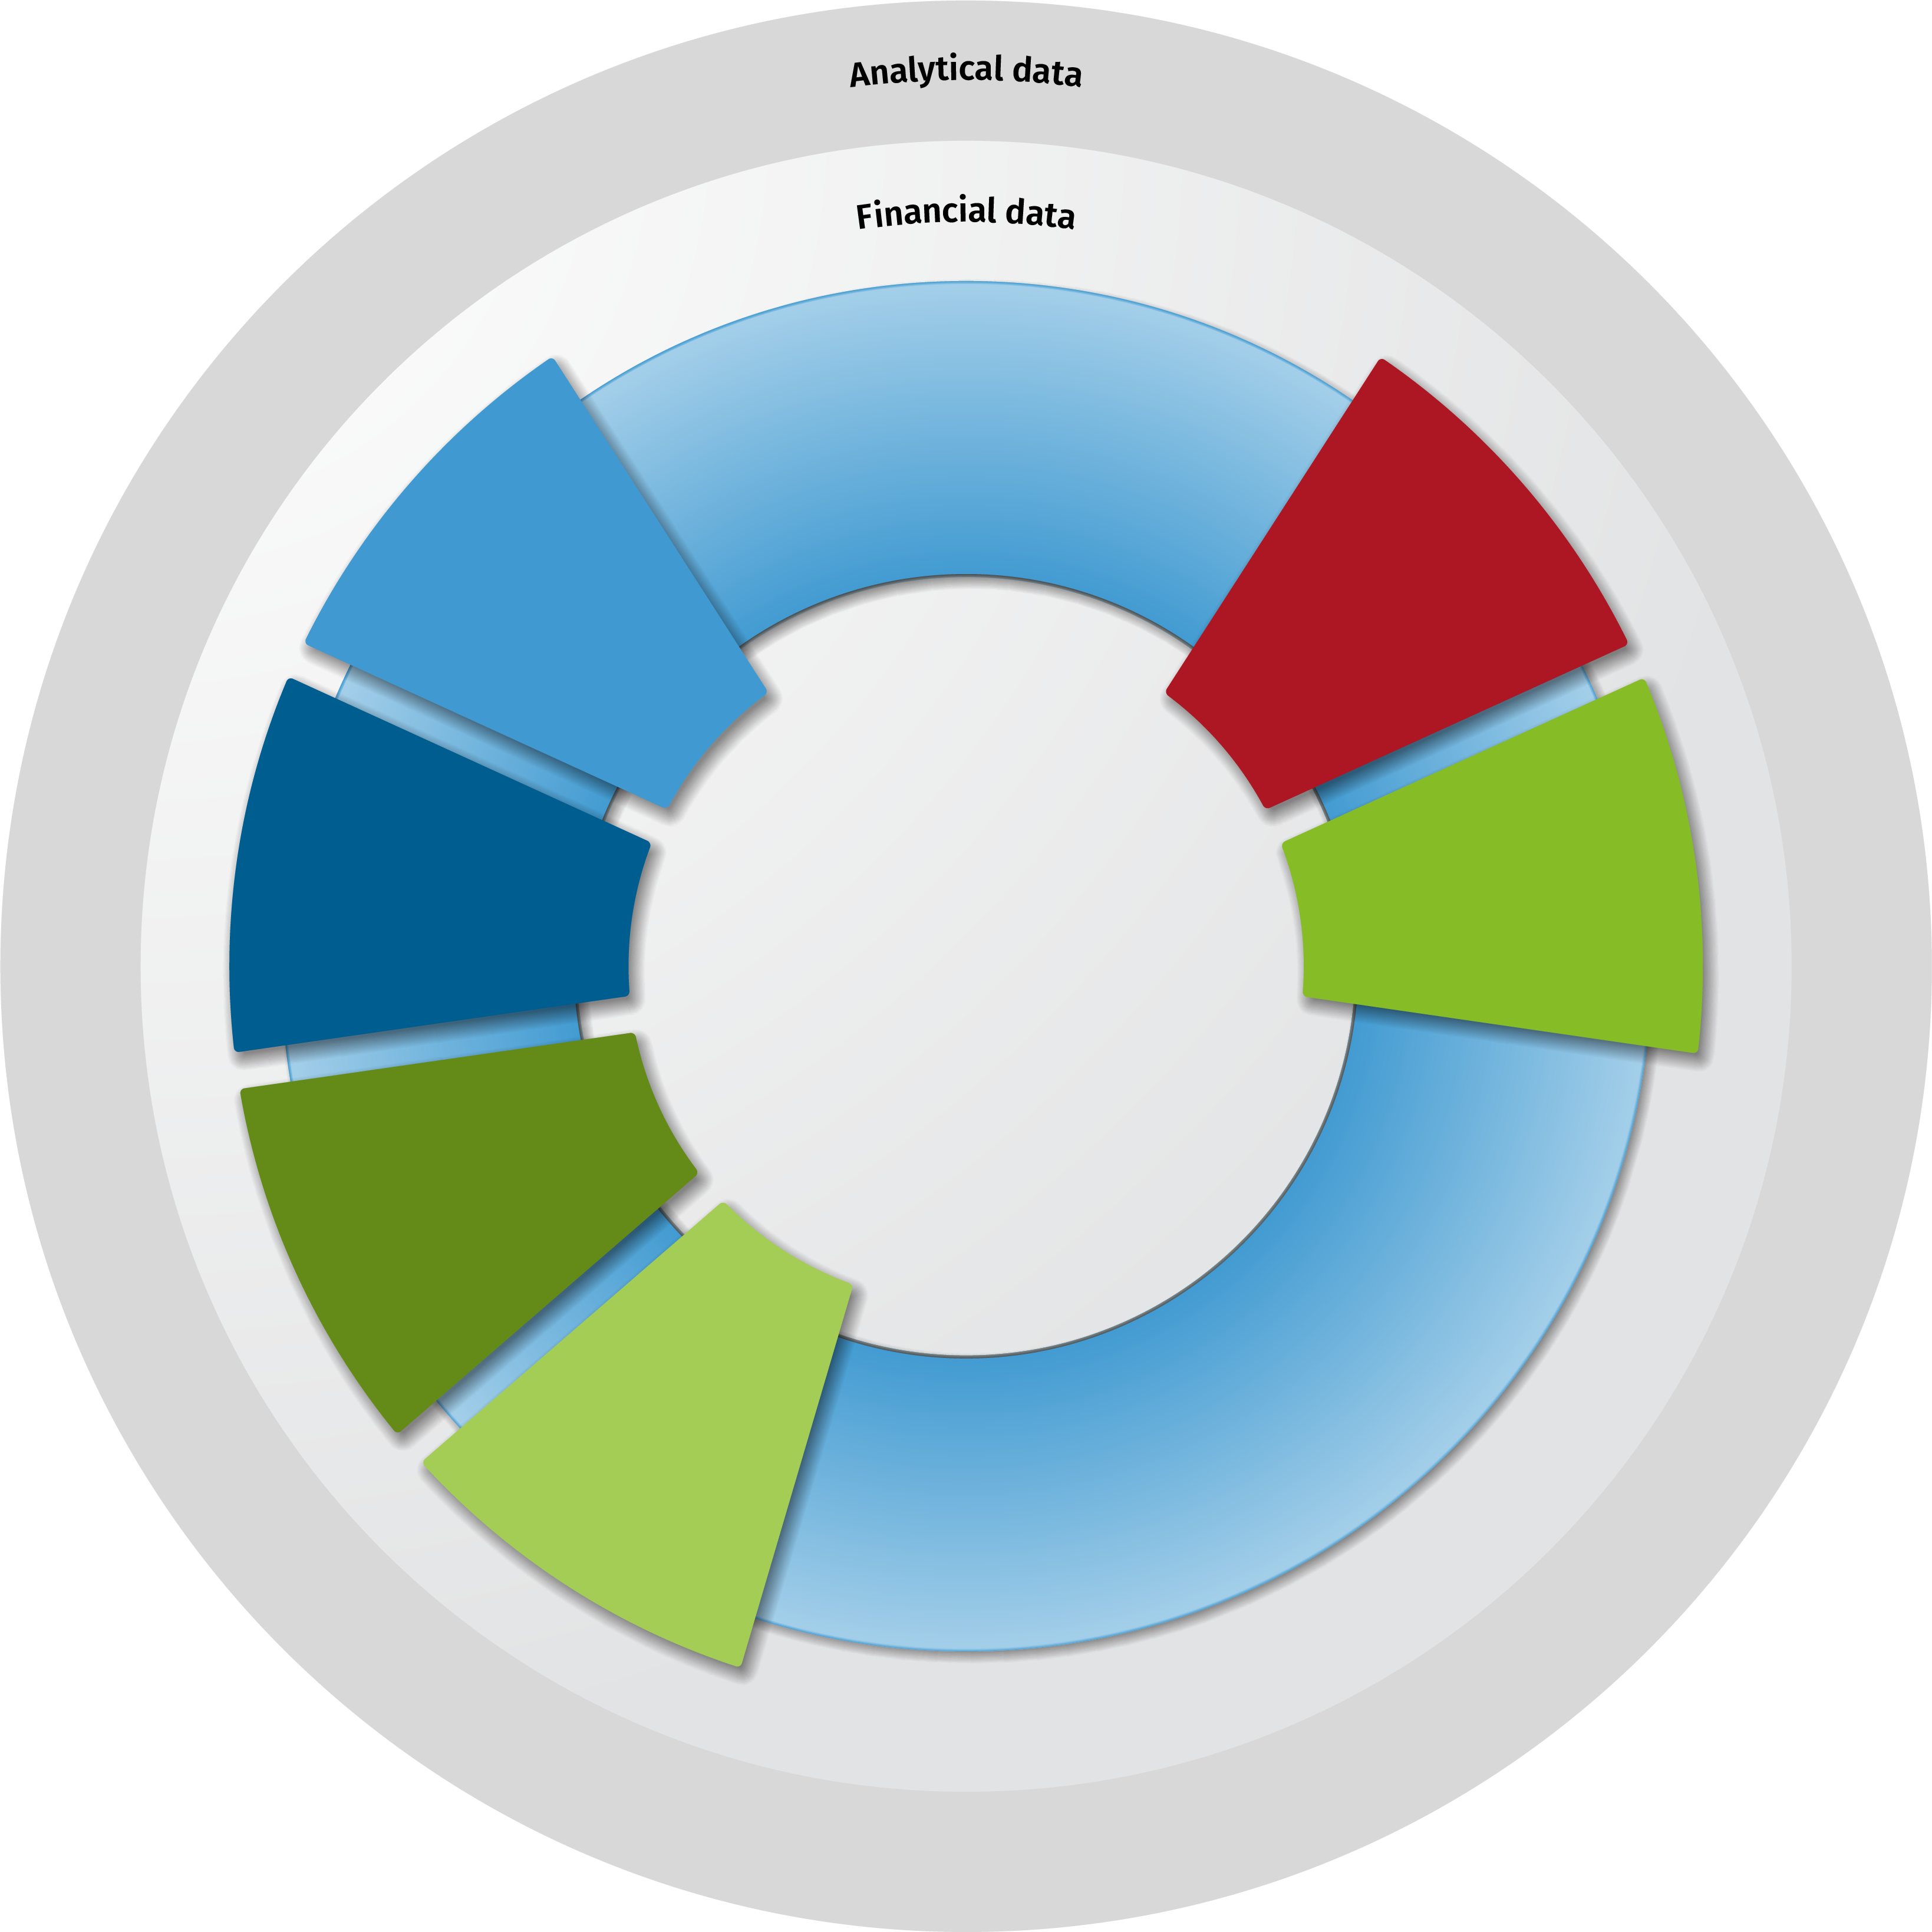
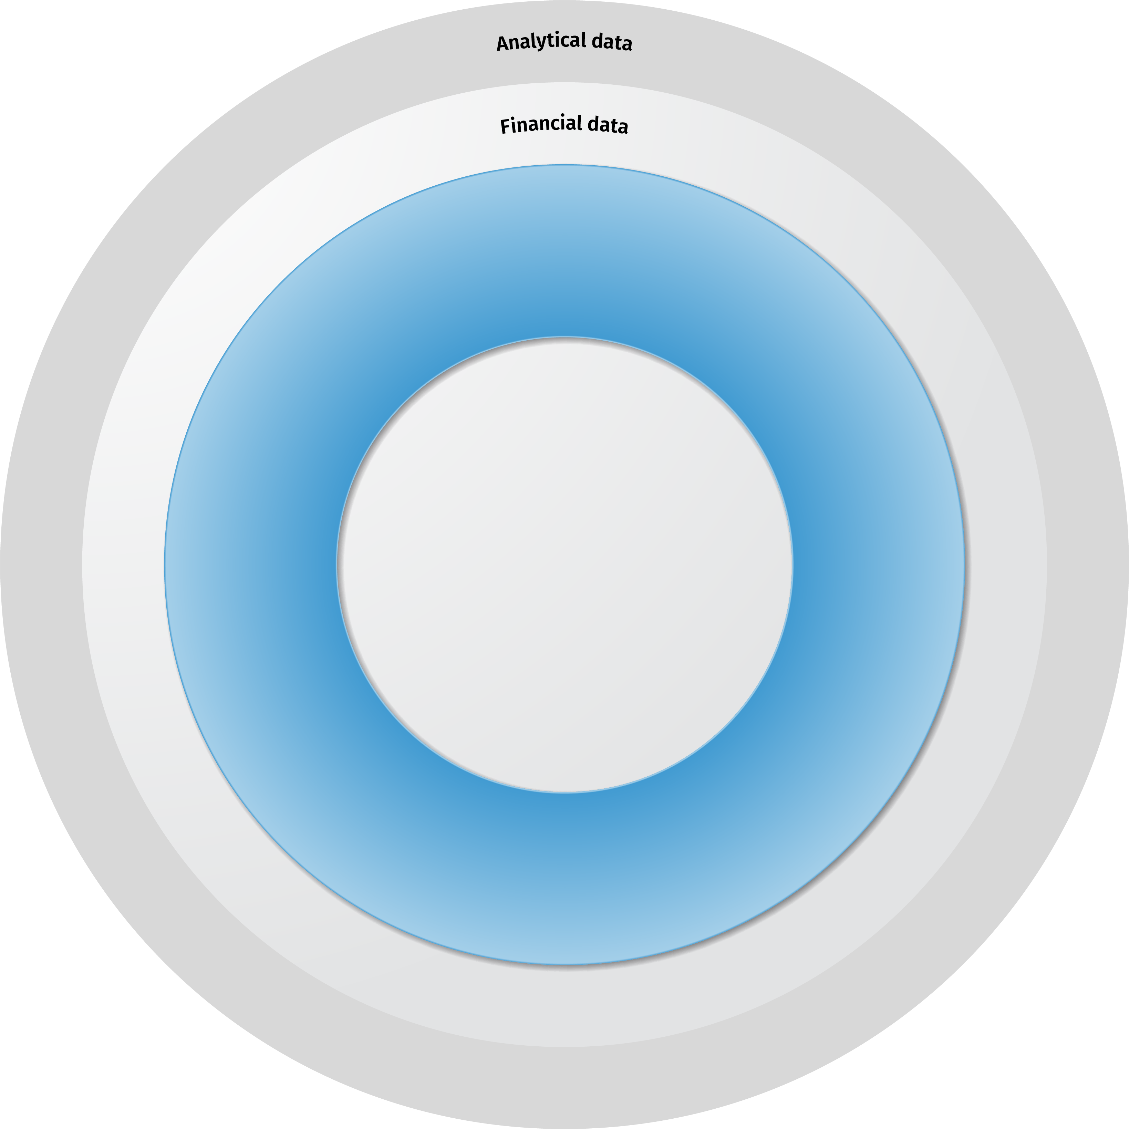
Predictive, Agile Planning powered by precision data:
Granular data at the core
Reporting and analytics, dashboard, variance analysis, scorecard, performance reporting, annual report
Extended
Planning
Planning Data
Scenario
planning
& analysis
Budgeting & Forecasting
Sales &
Operations Planning
Workforce/ Environmental Planning
Production
Cost Planning &
Control
ESG
Planning
CCH Tagetik Extended Planning
Faster, Deeper Insight: Drill into planning variances, drivers, and outliers down to SKU, cost center, product, or customer
Agile Scenario Modeling: Shift quickly from high-level views to tactical what-if simulations—at the speed of business.
Auditability & Traceability: Maintain line-item clarity with full data lineage from source to decision
Supply
Planning
Predictive
Analytics
Workflow &
collaboration
tools
Demand
Planning
Management
Reporting
Core platform features
Finance Data Hub -
data transformation, modeling,
and extensibility
CCH® Tagetik Corporate Sales Deck
Notes:
Along with the platform featuring AI we want to talk about our core product which is focused on providing you the ability to plan your supply chain and align those plans with your peers in finance, procurement and with corporate strategy.
As mentioned in the previous slide, many customers are leveraging the core functionality in our platform, along with planning capabilities to extend their planning beyond SCP. Click
Naturally, as you extend your planning for insights, you need to take in more data. One of our distinct advantages over our competitors is our ability to take in, manage and convert very large data sets into decision support information. This ability to manage and make useful granular data provides our customers significant benefits
Why does Granular Data Matter?
Modern planning is only as good as the data it’s built on. That’s why our roadmap starts with granular data management—giving supply chain leaders the ability to plan, model, and forecast with detail, flexibility, and confidence. In today’s environment, summary-level data isn’t just outdated—it’s a risk.
A risk that increases as you try to apply both Generative and Objective AI to that data
Next, I’m going to walk you through a couple of slides a customer presented at our In Touch conference. But first, When we get customers to these events, we often sit down and conduct interviews with them for marketing purposes. In this particular interview, the first question was related to why they had selected CCH Tagetik and the answer was a bit longer but it focused on the fact that they knew their IBP project was going to require a great deal of data from across the company. They felt CCH Tagetik technology was best positioned to manage that key requirement

Slide 17
Expanding into adjacencies
Uniquely positioned to deliver enterprise-wide planning
Extended
Planning
Sales
Are Sales projections aligned with the overall demand plan?
Finance
Are we still on track to hit our financial targets?
Plan the way you want to plan:
Operational planning across the enterprise
Department-specific granularity - product, people, SKU, etc.
Delivering composability with unlimited dimensions
FP&A retains common dimensionality for top-level data
FP&A maintains level of governance at the corporate level
CCH Tagetik
Marketing
Is Marketing spending in line with targets?
Supply Chain
Is our demand plan aligned with the revenue target and Sales plan?
IT
Do we have an underlying platform and staff to meet these needs?
Human Resources
Do we need to hire or reduce labor to hit targets?

Slide 18
CCH Tagetik provides the Platform to accelerate the automation of financial, operational, and tax processes
BOOK
CLOSE
CONSOLIDATE
COMPLY
PLAN
REPORT
Lease Accounting
Trial Balance Validation
Ownership Structure
ESG Compliance
Strategic Planning
Disclosure Mgmt., MD&A, Board Books
Insurance Accounting
Transaction Matching
Multi-GAAP Consolidation
Direct Tax Compliance
Annual Budgeting
Financial Reporting
Benefits for Customers
Transfer Pricing
Account Reconciliation
Currency Conversion
Indirect Sales & Use Tax Compliance
Rolling Forecasts
Management Reporting
Indirect Tax Determination
Allocations
Tax Provision and Reporting
Solvency II
Demand & Supply Chain Planning
Ad Hoc Smart Insights
One-stop-shop for all Finance-owned processes
Implement new solutions rapidly
Configuration instead of customization
Continually innovating to solve the latest business challenges
Support future growth and increased business complexity
Month End Workflow Closing Tasks
ESG KPI Consolidation
EBA Supervisory Reporting
Driver Based & Zero- Based Planning
Data Visualization, Power BI, SAC, Qlik
Journal Entry
iXBRL
IBP - Sales, HR, Opex, Capex & Project
ESG Reporting
Intercompany Matching & Eliminations
Country-by-Country Reporting (CbCR)
COGs Planning
Movement & Continuation Schedules
Global Minimum Tax Requirement
ESG Planning
Balance Sheet & Cash Flow Planning
Predictive Planning (AI/ML)
AI-powered Solutions
Notes:
Our ability to meet full end to end close
With our solution, we support our customers in every step of their daily financial, operational and tax processes allowing them to have a 360 degree view of their organization, never leaving them alone (in a good way) and helping them extend to and automate areas of their business that they had never even dreamt of at the beginning of their software evaluation, of course without compromising their most pressing needs.
We help them with pre-close activities such as booking entries in their ERP systems through our semi-transactional offerings such as lease accounting or we help them close their books with confidence on a monthly or quarterly or annual basis through our workflow oriented solutions that help streamline the closing process
We help them consolidate their close acting as the best accountants sitting right next to them that are always up-to-date with the latest accounting principles and never make a mistake!
We make sure they are compliant and build audit defense through our regulatory and tax offerings in the areas of ESG, Pillar II, Corporate Direct and Indirect Tax
We enable them to look forward with a plethora of planning solutions that vary from c-level executive strategy setting to financial plans and detailed business and operational plans that naturally talk and integrate with each other
And of course we empower our users to evaluate their actions through a magnitude of reporting options from Disclosure Management and Narrative Reporting to Financial & Management Reporting and Ad-hoc dashboarding and data-visualization.
If this does not mean extensibility to support a full 360 view of your organization, I do not know what does!
And this is all us, all at CCH Tagetik...now think if we were to even extend within our TAA division or even at the WK level. With solutions like Teammate for internal and external auditing needs or complementary solutions like Enablon or OneSumX that further enhance existing offerings within our Core CCH Tagetik offering, we take extasibility to the next level – but that is just for awareness today – let's stay focused for now on what we have in house which is a lot!
What does this all mean for our customers:
Accelerate delivery of new applications and business insights.
Deploy new solutions rapidly, and at low costs
Support future growth and increased business complexity without new software, same UI
And what's in it for you, account executives, sales exectuives, RSMs, and in general our extended sales organization?
There is MONEY in it for you, for all of us. You can get to an account from multiple different angles depending on what matters most to your prospect and keep expanding. Land and Expand strategy within your territory. CROSS SELLING. It is all about territory management, going back to your territory and map the white space for your customers. I can guarantee you that you can pick ANY of the customers you have in your territory and there will be something we can extend their experience with CCH Tagetik for.
So now, let's take a look at some areas of extension we want to focus on in 2023.

Slide 19
Enterprise Planning aids the Office of the CFO in driving strategic decisions and delivering financial results
Extended
Planning
Enterprise Planning ⬄ Integrated Business Planning
Customers are resilient with finance-forward operational planning
Strategy
+
Financial
+
Operational
+
ESG
=
Fully Aligned
Enterprise
Strategic Planning
Budgeting, Planning & Forecasting
Cash Flow, Capex/Opex Profitability Planning
Sales & Marketing
Planning
IT
Planning
Production
Cost Planning & Control
HR/Workforce
Planning
Supply Chain Planning
Sustainability Planning & Analytics
Enterprise Planning
Strategic / Long Range Plans
Revenue Planning
Balance Sheet Planning
Scenario Planning
OpEx / CapEx Planning
Sales & Service Planning
Product Mix Planning
Procurement Planning
Aligned S&OP
Demand Planning / Forecasting
Supply Planning / Inventory
Capacity Planning
Lifecycle & Assortment
Workforce Planning
IT / Support Planning
Project Planning
CCH® Tagetik Corporate Sales Deck
Notes:
CCH Tagetik delivers enterprise-wide planning. Our customers continue to look to our connected planning platform to align strategy, financial and operational and ESG plans including sales & marketing, IT, Sustainability, Workforce/HR and full supply chain planning. This year we want to highlight that we continue to see increasing interest in ESG planning topics which driver further resilience and long term growth, The planning journey can start where customers believe the most value will be delivered and extend into adjacent planning areas working across any time horizon on a platform with unified collaboration, workflow and reporting capabilities. Our ‘explainable’ AI-based probabilistic predictive planning assists planners in selecting the best fit forecast, identifying outliers and implementing corrective actions.
The ability for financial planners to see, understand and act on operational activities which impact business performance and align plans within planning periods sets CCH Tagetik apart in the market
As an example of a customer driven innovation in the past year, CCH Tagetik has delivered an ESG focused solution accelerator for planners to see performance to goals along a range of environmental metrics
62 seconds
In CCH Tagetik, planning customers utilize the enterprise-solution for developing and executing both financial & operational plans, including sales, marketing, IT, Workforce among others. Ultimately, the ability to include end-to-end supply chain planning to financial & ops planning, sets CCH Tagetik apart in the market.
As an example of a solution accelerator for planners, CCH Tagetik delivered an Integrated ECO planning solution to perform ESG impact analysis across planning scenarios.
30 seconds

Slide 20
Our pervasive use of AI elevates all intelligent solutions
Example use cases
AI
Automapping
AI Transaction Matching
AI Anomaly
Detection
AI Driver-based
Analysis
Predictive
Intelligence
Financial Close
Map new G/L source file
ESG
Map ESG scope 3 data for new entity
Regulatory
Map new lease source file for IFRS 16 / ASC 842 Leases
Financial Close
Map external transactions to internal transactions
Financial Close
Outlier detection in Mar 2024 G/L actuals
Corporate Tax
Outlier detection for Tax Q1 2024 actuals
ESG
Spot inconsistencies between financial and not financial data
Planning
Outlier detection in SCP data for Jan 2024
Financial Close
Determine the key driver for increased costs YoY for Jan 2024
ESG
Determine how your non-financials are impacting your financials
Planning
Determine key actions to take to maximize the sales for each product line in EMEA
Planning
Update rolling forecast for 2024
Determine top marketing campaign for 2023
Create the 2024 probabilistic supply chain plan
Create the integrated business LRP for 2025 to 2027
CCH® Tagetik Corporate Sales Deck
Confidential under the terms of our Services Agreement

